Slide 1

Process-based models III

Slide 2
Population
dynamics
Space (& dispersal)
Biotic interactions
+
+
=
Metacommunity dynamics

Slide 3
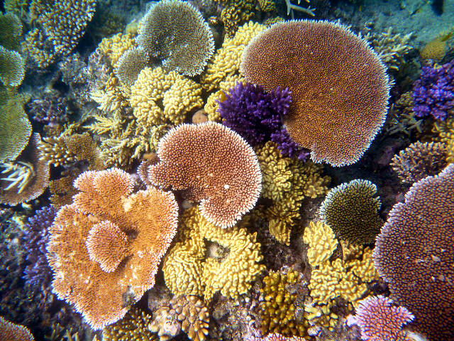
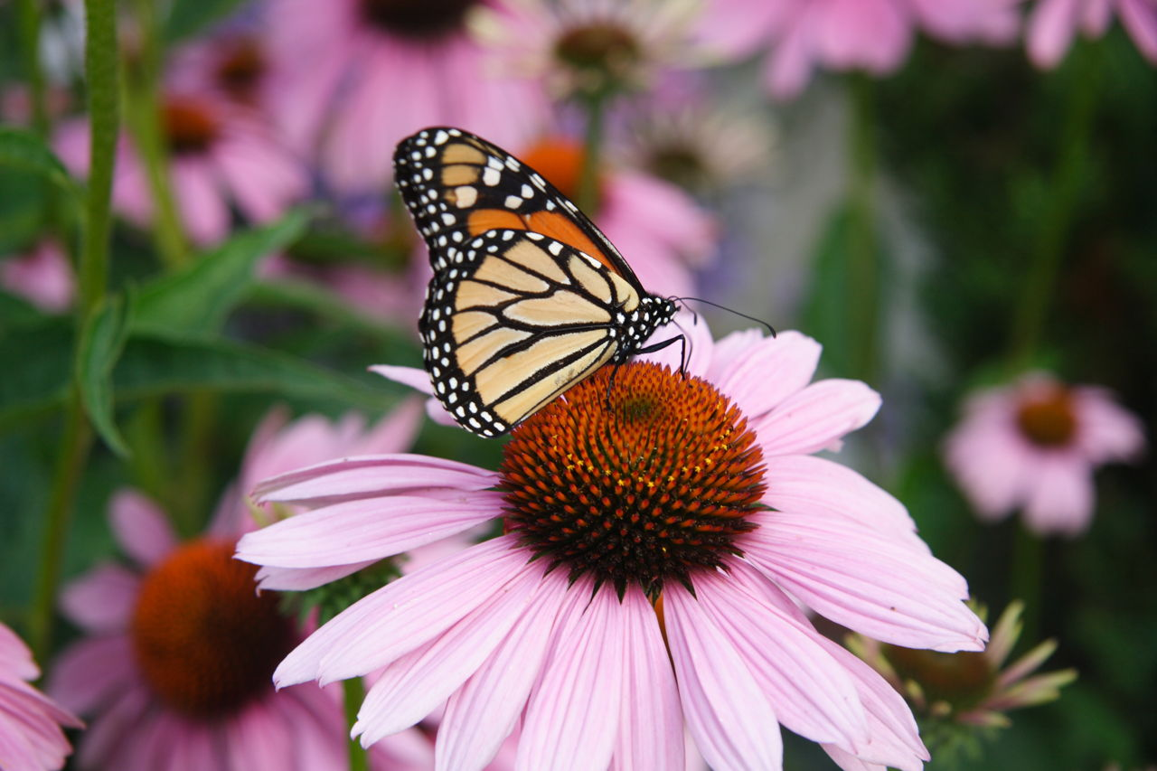
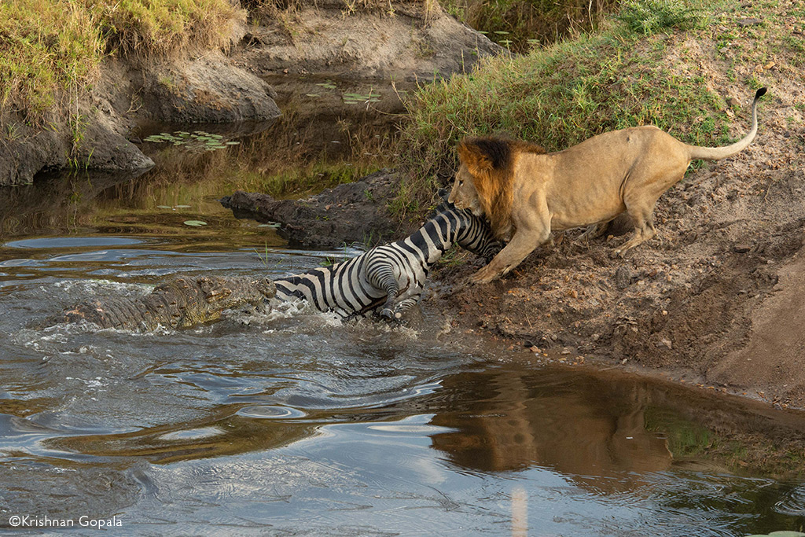
Biotic interactions
Intraspecific and interspecific
Competition
Predation
Herbivory
Symbiosis: mutualism (+,+),
commensalism (+,0), parasitism (+,-)

Slide 4
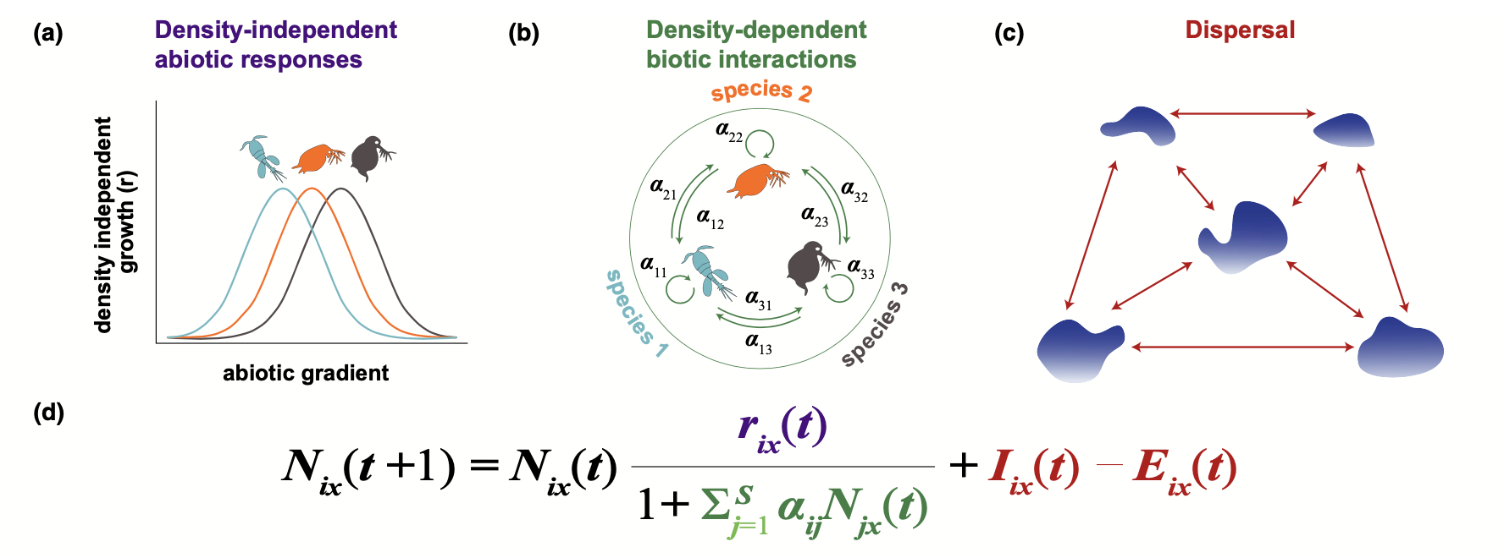
Population
dynamics
Space (& dispersal)
Biotic interactions
+
+

Slide 5
Population
dynamics
Space (& dispersal)
Biotic interactions
+
+

Slide 6
Population
dynamics
Space (& dispersal)
Biotic interactions
+
+

Slide 7
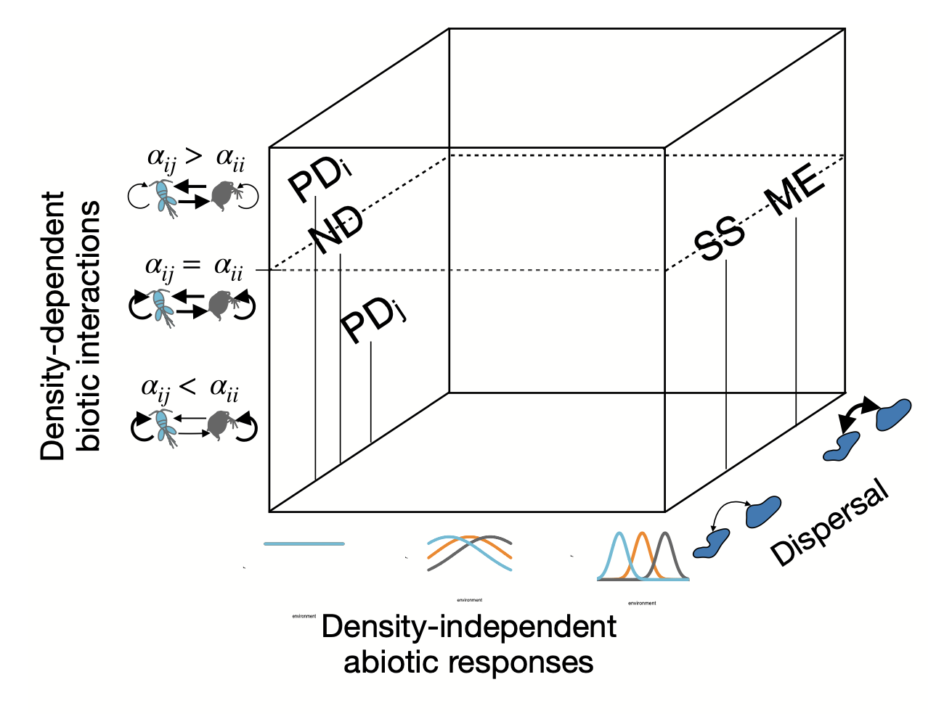

Slide 8

Thompson et al. 2020 Ecol Lett

Slide 9
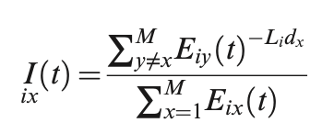
Thompson et al. 2020 Ecol Lett

Slide 10
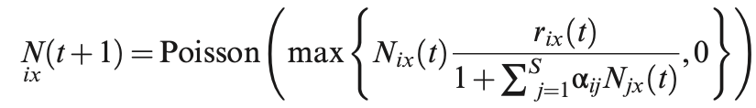
Thompson et al. 2020 Ecol Lett

Slide 11
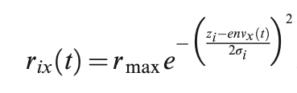
Thompson et al. 2020 Ecol Lett

Slide 12
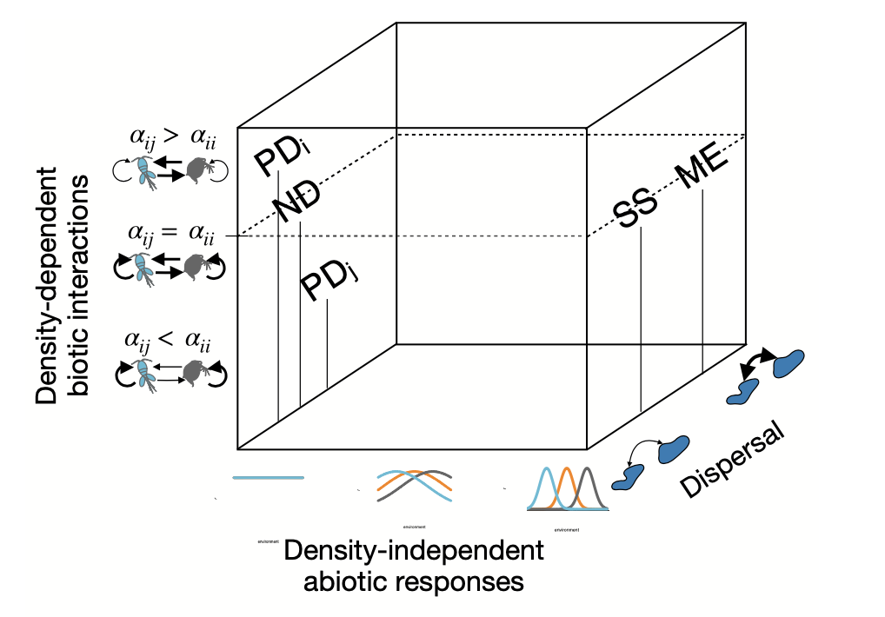
Computer exercises
Metacommunity dynamics

Slide 13
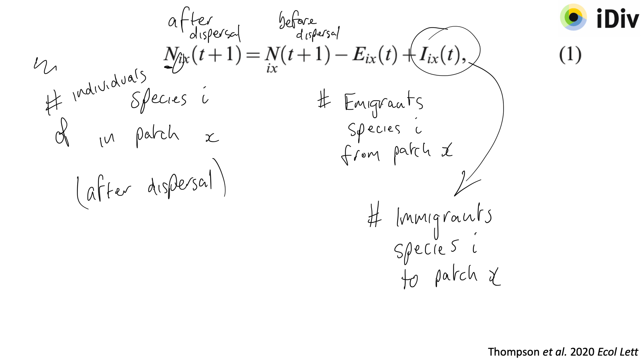
Thompson et al. 2020 Ecol Lett

Slide 14
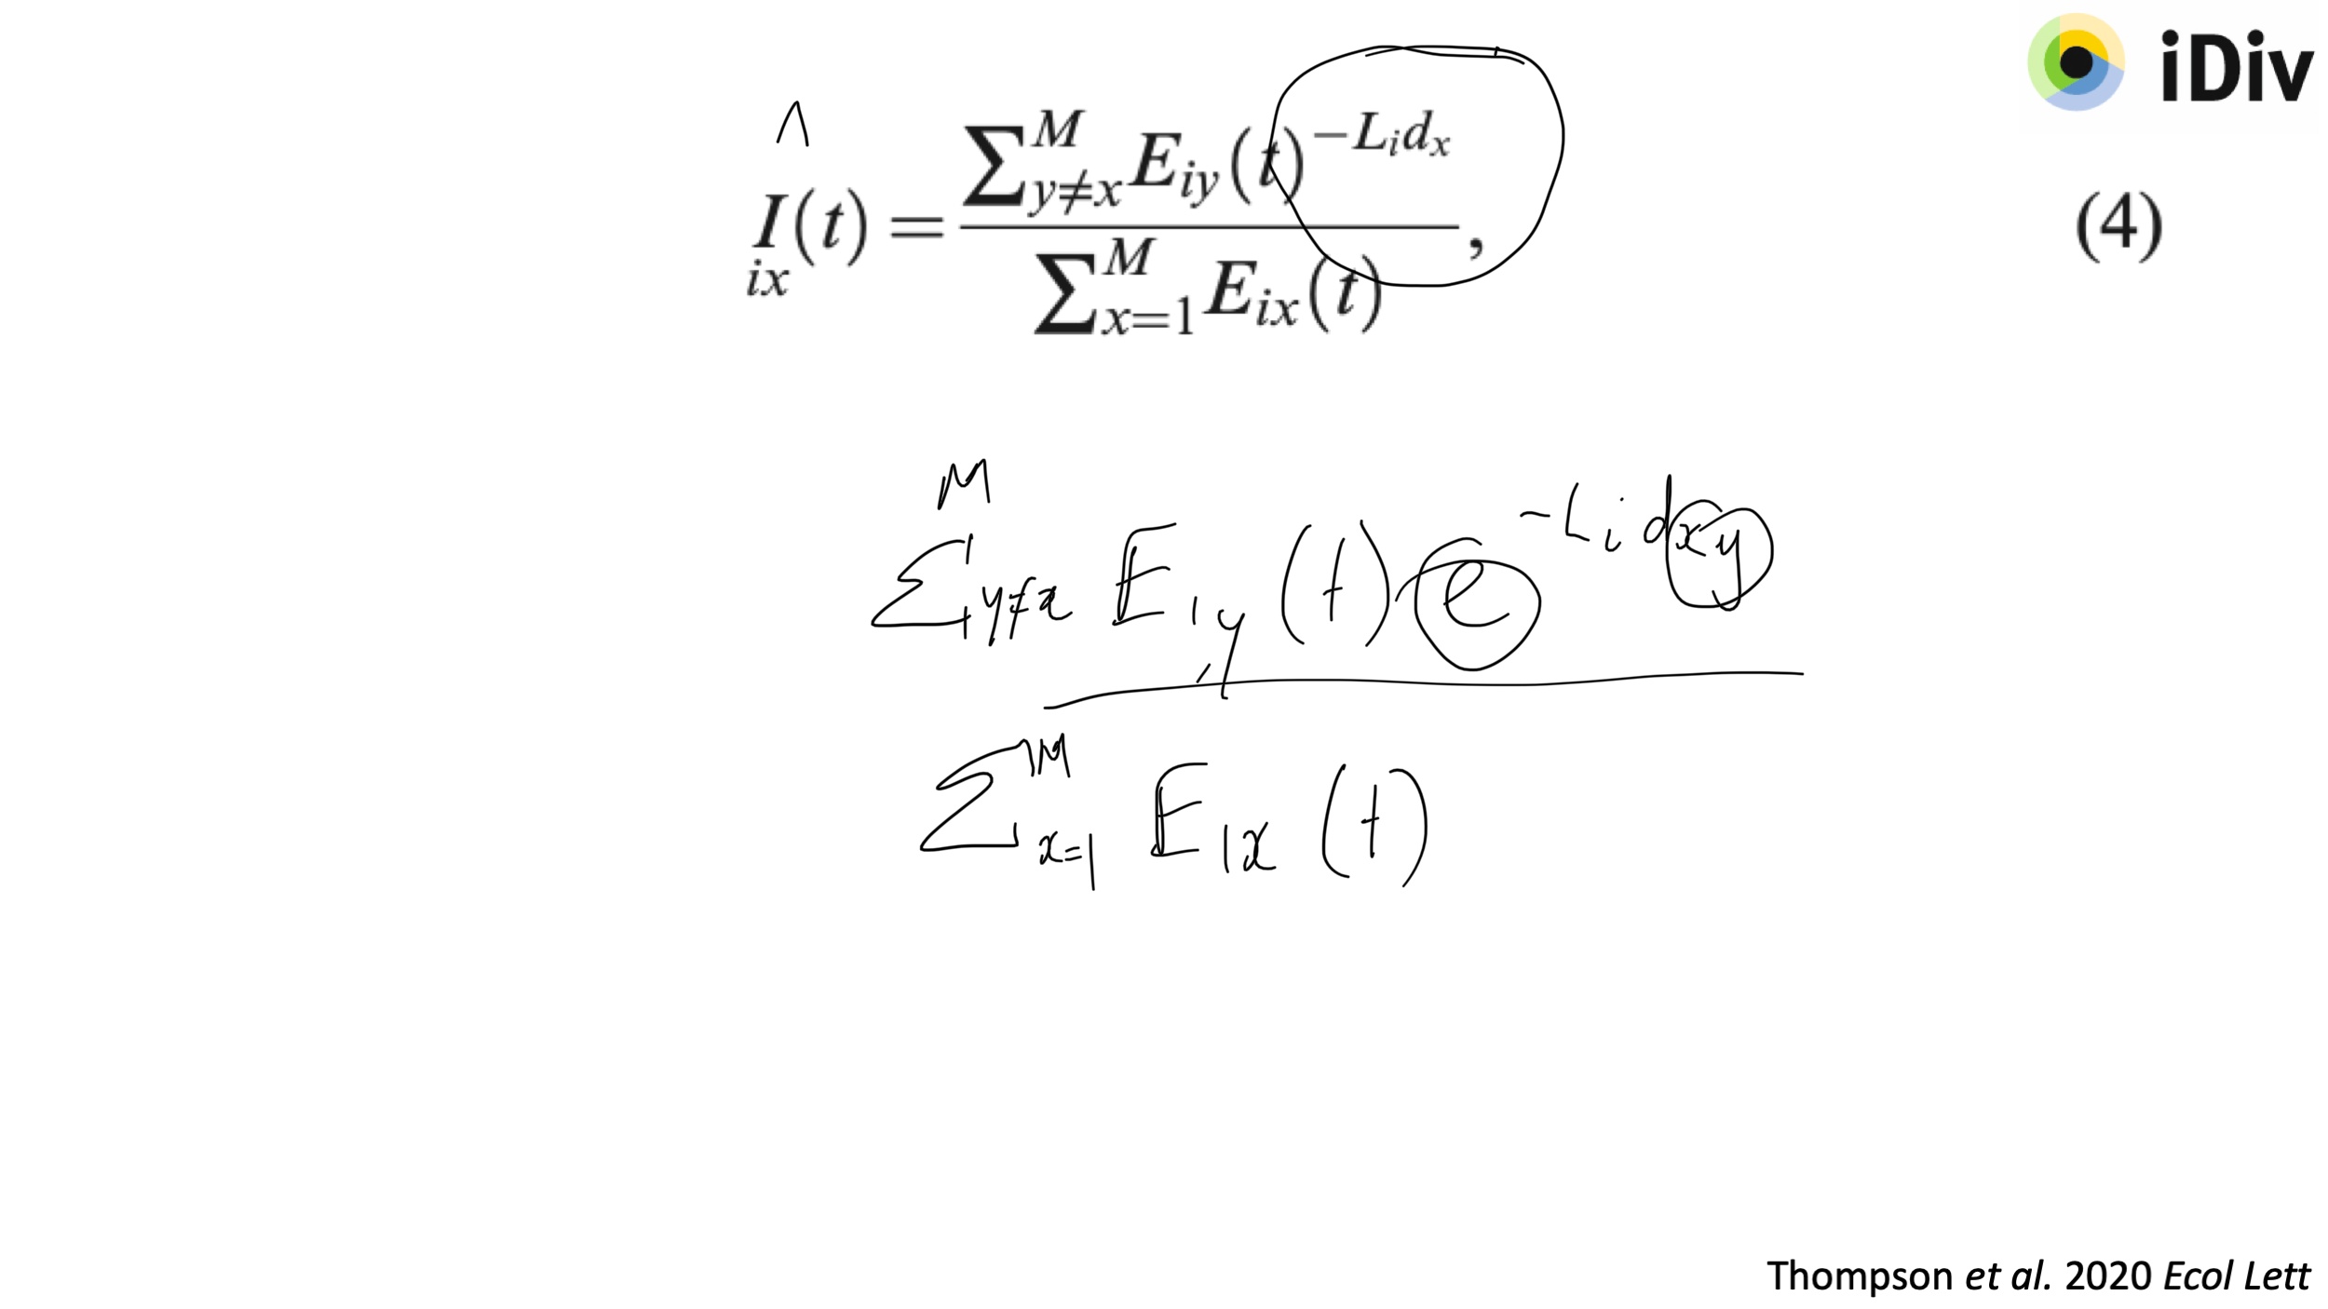
Thompson et al. 2020 Ecol Lett

Slide 15
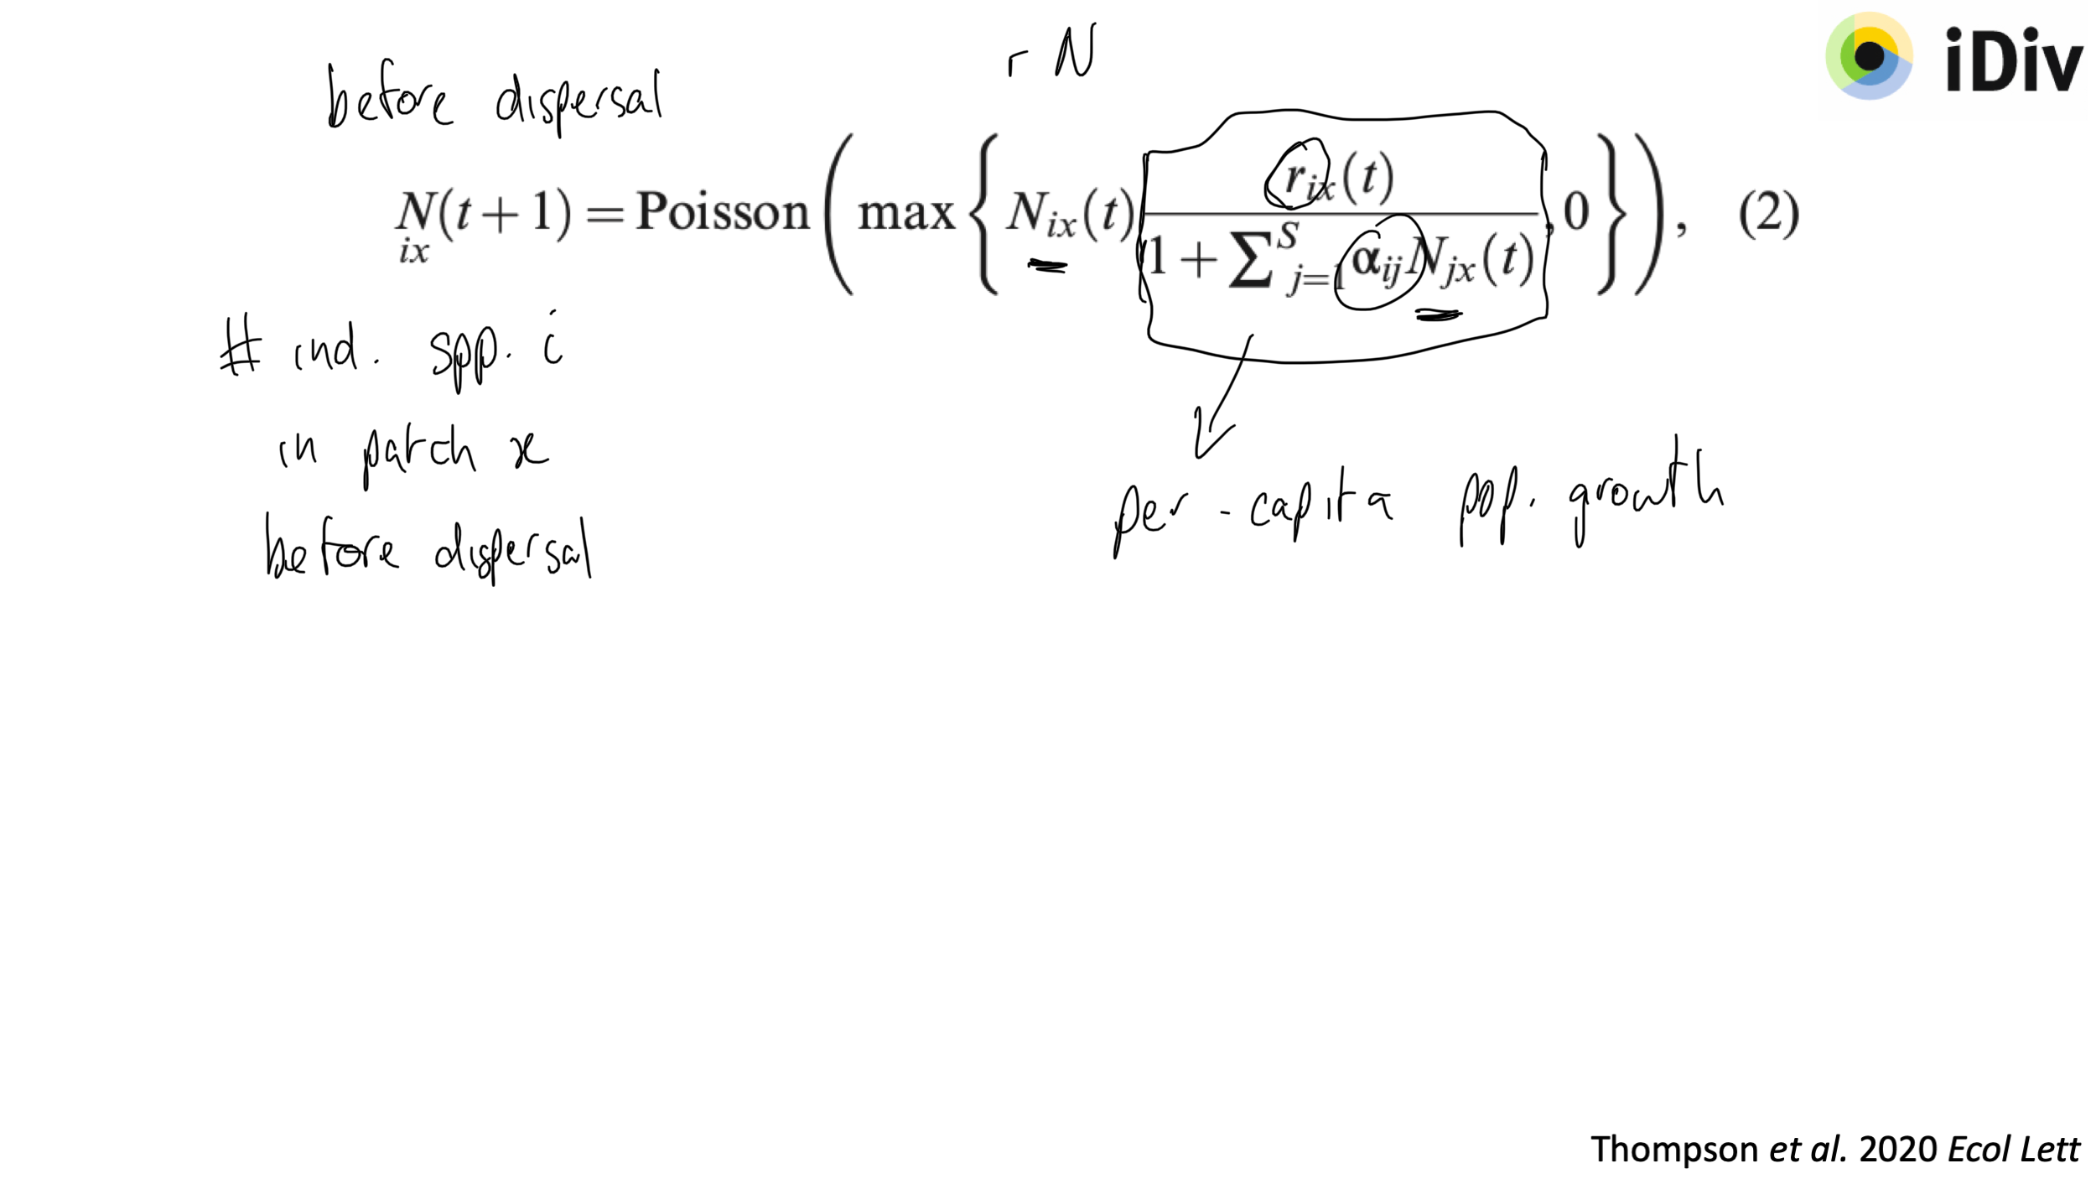
Thompson et al. 2020 Ecol Lett

Slide 16
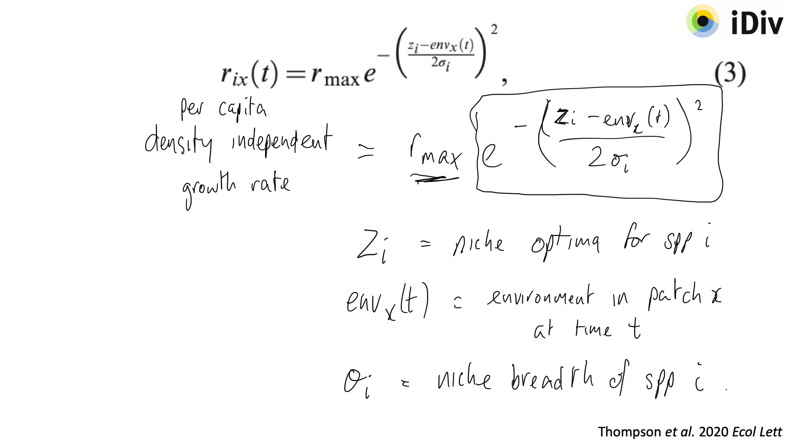
Thompson et al. 2020 Ecol Lett

Slide 17
Revisit: Models and the Scientific Method

Slide 18
Revisit: Models and the Scientific Method
“…scientific method cannot be reduced to a statistical procedure.”
Observation of a pattern (description)
Propose explanation (how or why)
Hypotheses != models
Deriving explanations & predictions from scientific theory:
‘Theoretical modelling’
Make prediction
Confronting models with data:
Statistical analysis & visualisation:
‘Statistical modelling’
Conduct experiment
Interpretation
McElreath 2018 Statistical rethinking

Slide 19
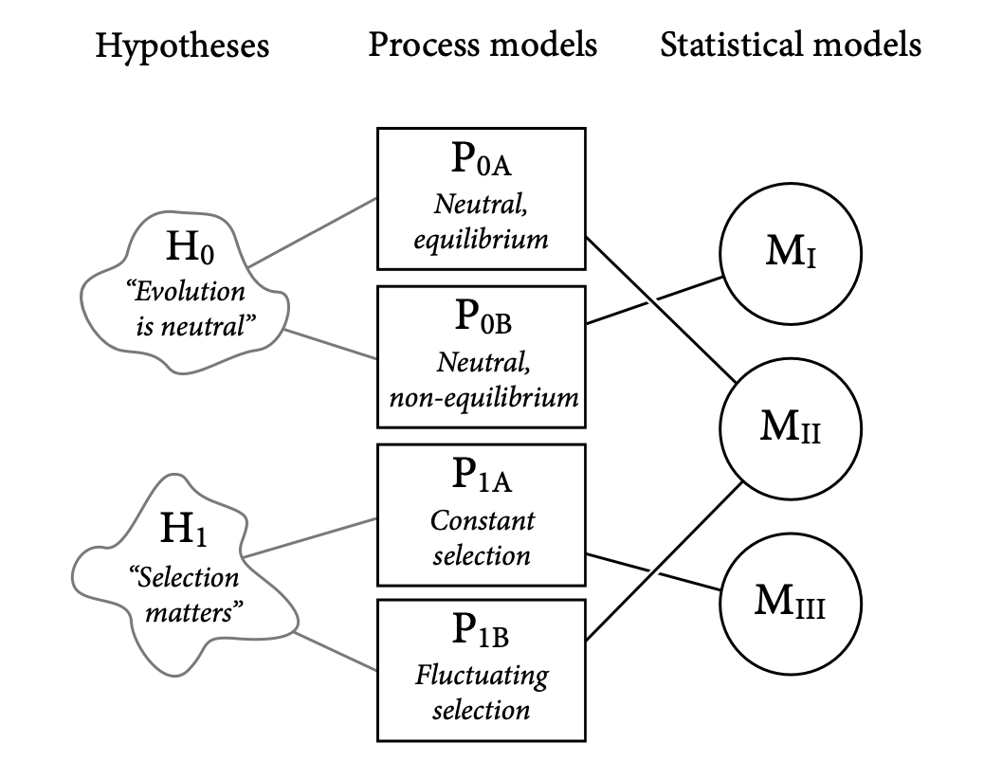
Example: neutrality vs selection in evolution
McElreath 2018 Statistical rethinking
Notes:
In order to turn the hypotheses into process-based models, additional assumptions need to be made (and formalised), e.g., population structure, number of sites, number of alleles, mutation rates, etc. Having made some choices (assumptions), we can derive process models. E.g., P0A and P0B differ in their assumptions about population size and structure: P0A assumes it has been constant long enough for the distribution of alleles to have reached a steady state. Similarly, many different process models can be derived for the “selection matters” hypothesis. Need statistical model to challenge the process models with evidence (data). E.g., P0A produces a power-law distribution of alleles (MII). Unfortunately, so does P1B!

Slide 20
Example: neutrality vs selection in evolution
A statistical model can correspond to multiple process models.
A hypothesis may correspond to multiple process models.
A statistical model can correspond to >1 hypothesis.
McElreath 2018 Statistical rethinking
Notes:
In order to turn the hypotheses into process-based models, additional assumptions need to be made (and formalised), e.g., population structure, number of sites, number of alleles, mutation rates, etc. Having made some choices (assumptions), we can derive process models. E.g., P0A and P0B differ in their assumptions about population size and structure: P0A assumes it has been constant long enough for the distribution of alleles to have reached a steady state. Similarly, many different process models can be derived for the “selection matters” hypothesis. Need statistical model to challenge the process models with evidence (data). E.g., P0A produces a power-law distribution of alleles (MII). Unfortunately, so does P1B!

Slide 21
Example: neutrality vs selection in evolution
A statistical model can correspond to multiple process models.
A hypothesis may correspond to multiple process models.
A statistical model can correspond to >1 hypothesis.
Potential solution:
Use multiple models. Want to compare (possibly multiple) predictions of more than one model.
McElreath 2018 Statistical rethinking
Notes:
In order to turn the hypotheses into process-based models, additional assumptions need to be made (and formalised), e.g., population structure, number of sites, number of alleles, mutation rates, etc. Having made some choices (assumptions), we can derive process models. E.g., P0A and P0B differ in their assumptions about population size and structure: P0A assumes it has been constant long enough for the distribution of alleles to have reached a steady state. Similarly, many different process models can be derived for the “selection matters” hypothesis. Need statistical model to challenge the process models with evidence (data). E.g., P0A produces a power-law distribution of alleles (MII). Unfortunately, so does P1B!

Slide 22
Independent project
Use the Thompson metacommunity model to address a research question. For example,
- How does habitat loss and/or fragmentation impact biodiversity?
- How do environmental changes impact biodiversity?
Prepare a 10 minute presentation to deliver Friday afternoon

